Slide 1
MAJOR
PROJECT- 2
NAME: Rai Guru Raj
BATCH: Power BI (24th June)
Email: sahil6rai@gmail.com

Slide 2
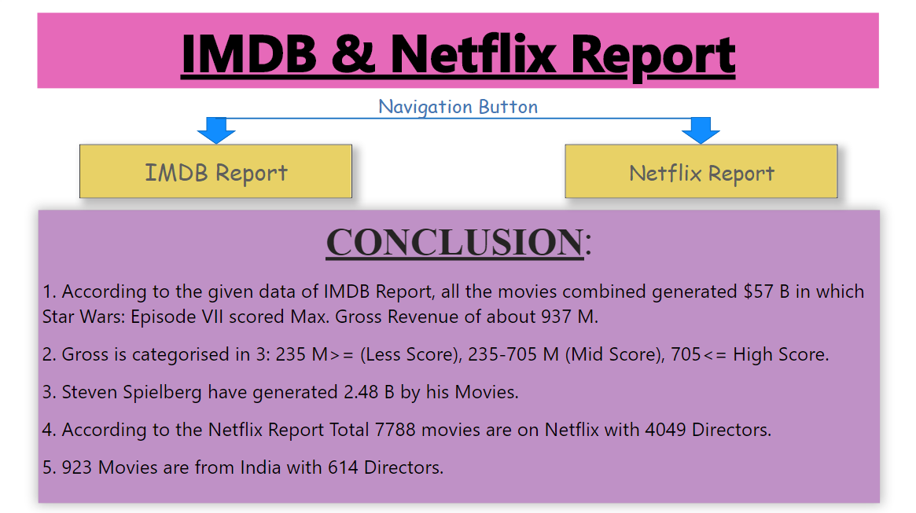
Page 1: Navigation (HOME)

Slide 3
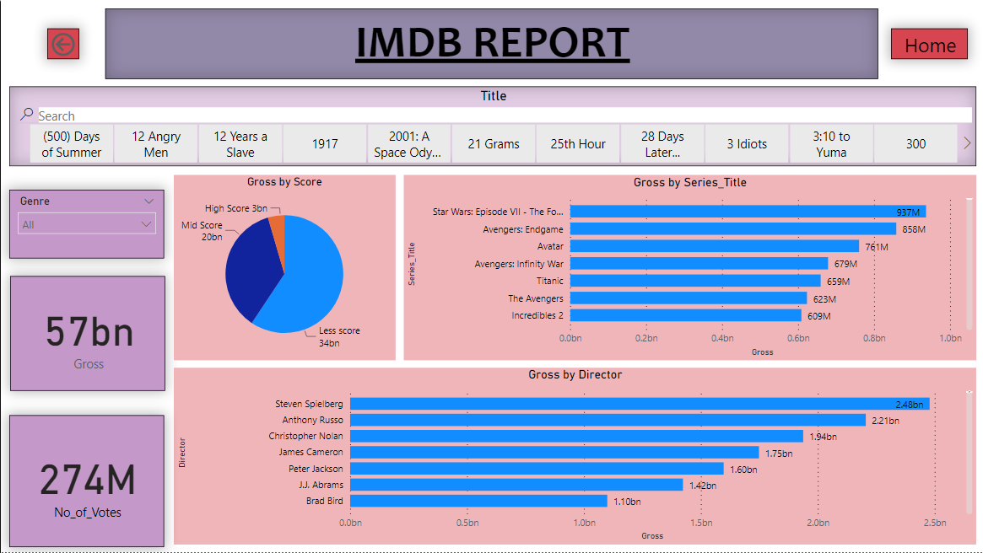
Page 2: IMDB Report

Slide 4
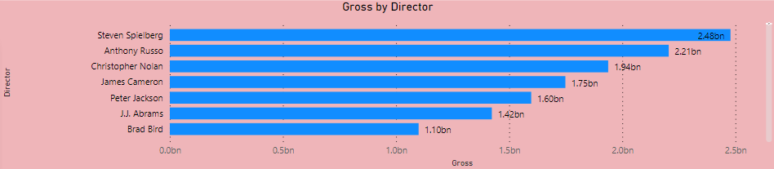
Page 2: IMDB Report
The Clustered Bar Chart shows the gross revenue generated by Directors after the release of their respective movies and tv shows.
Steven Spielberg has the highest revenue from the movies with $ 2.48B followed by Anthony Russo and Christopher Nolan with $ 2.21B & $ 1.94B respectively.
This is just a list of Top 20 highest revenue generating directors for the industry.

Slide 5
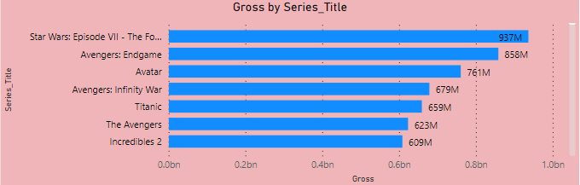
Page 2: IMDB Report
The Clustered Bar Chart shows the movies with highest revenue. This is a list of only top 30 movies with biggest collection of all time.
Star Wars has almost reached 1B mark with the revenue of $ 937 M. Second & third spot are with Avengers Endgame & Avatar.

Slide 6
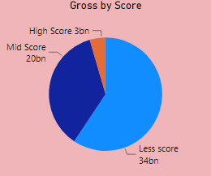
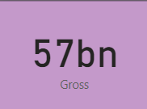
Page 2: IMDB Report
This Slicer shows Movie Titles.
The Pie Chart above displays gross revenue on the basis of movie score.
Gross is categorised in 3:
235 M>= (Less Score), 235-705 M (Mid Score), 705<= High Score.
This card shows total gross revenue generated by 1000 movies.

Slide 7
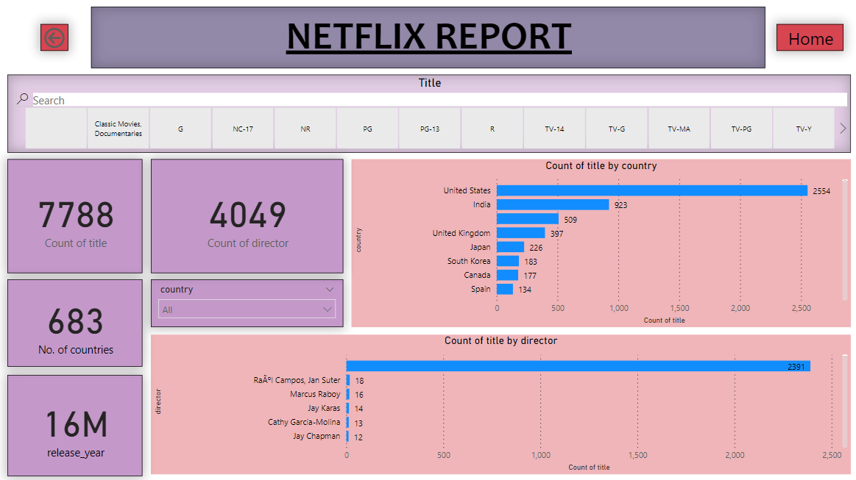
Page 3: Netflix Report

Slide 8
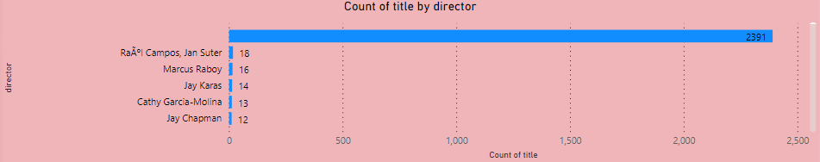
Page 3: Netflix Report
The Clustered Bar Chart displays number of movies and tv shows by the respective directors.
Campos has directed most movies(18). Marcus Raboy and Jay Karas have directed 16 and 14 movies respectively.
This is a list of top 20 directors with highest directed movies.

Slide 9
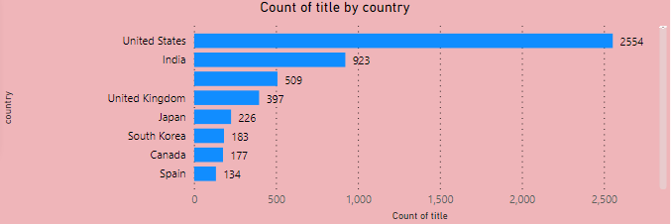
Page 3: Netflix Report
The Clustered Bar Chart shows the number of movies made in different countries. This is the list of just top 10 countries with most movies made there.
United states lead the table with 2554 movies and India with 923 movies.
Rest countries have few movies made there.

Slide 10
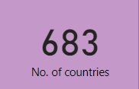
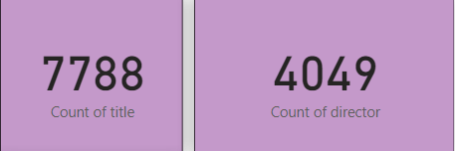
The Slicer here display Rating given to Titles
Page 3: Netflix Report
The cards here display number of movies
The cards here display number of movies and number of directors.

Slide 11
All the top 1000 movies on IMDB have generated $ 57B.
Star Wars: Episode VII scored Max. Gross Revenue of about 937 M.
Gross is categorised in 3: 235 M>= (Less Score), 235-705 M (Mid Score), 705<= High Score.
Steven Spielberg have generated 2.48 B by his Movies.
According to the Netflix Report Total 7788 movies are on Netflix with 4049 Directors.
923 Movies are from India with 614 Directors.
Gross revenue by Director gives us Top 20 directors by revenue their movies have earned.
Gross revenue by Title gives us Top 30 highest grossing movies of all time on IMDB.
Netflix Report presents all the count details of Movies & TV shows with respect to Directors & Country.
The Report conveys Top 1000 IMDB movies and Netflix TV Shows. All the data has been presented in a simple & standardized way so that user can easily interpret the vast data and take necessary decisions.
CONCLUSION

Slide 12
THANK YOU

